Slide 1
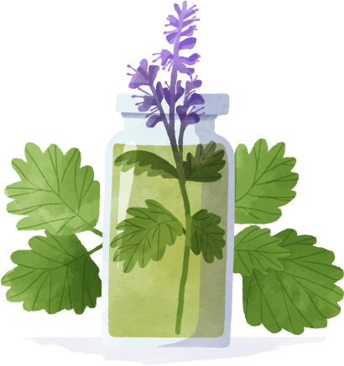

Aromatherapy
Potential Benefits of Using Essential Oils
CAUTION: Do not use in place of regular medical treatment and avoid if you have sensitivity or allergic reactions to oils/aromas.
Notes:
Welcome and thank you for attending today’s session on Aromatherapy: Potential Benefits of Using Essential Oils.
Today we are going to learn about what some research is telling us regarding Aromatherapy and review some of the most common essential oils being used. However, before we get started, I want to ensure that everyone knows two important points:
Aromatherapy should never be used to replace a medical treatment, always seek and follow healthcare provider, physician and medical treatment plans. Discuss potential use of essential oils with healthcare providers.
Always be careful when using or encouraging use of essential oils, as some individuals are highly allergic or sensitive to oils, which can lead to triggering migraines, nausea, rashes, etc.
Now let’s get started with today’s presentation!
NEXT SLIDE

Slide 2


Today's Learning Objectives
01
02
03
04
Define Aromatherapy
Identify Commonly Used Essential Oils & Possible Benefits
Discuss Carrier Oils &
Their Role in Aromatherapy
Understand Safety &
Precautions when using essential oils
Notes:
We are going to discuss 4 areas related to Aromatherapy today. We will begin by
Learning a little bit about the history of Aromatherapy and define what exactly is Aromatherapy.
Next, we will review what research tells us about the most common used essential oils and the potential benefits of Aromatherapy.
Then we will dive a little deeper and discuss carrier oils and their role in aromatherapy.
Lastly, we will discuss safety, precautions and side effects when using essential oils.
NEXT SLIDE

Slide 3
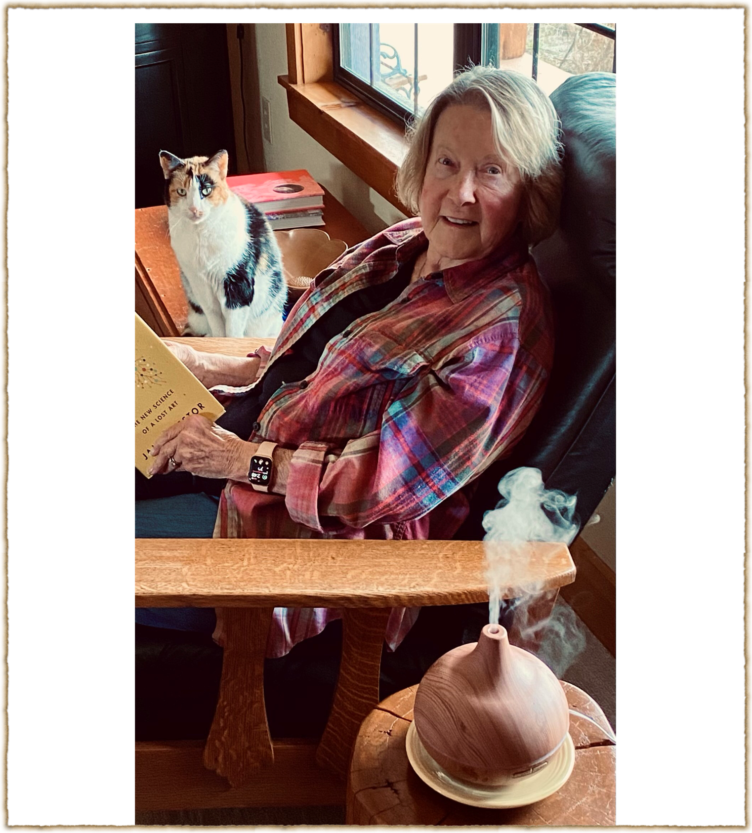
Enjoying the benefits of aromatherapy!
Notes:
You are welcome to provide an example of personal use of aromatherapy here.
Examples could include-use of Shower soothers (Vicks Vapo Soothe.rs) to help open stuffy noses, Candles or diffusers with Lavender to help relax before bedtime, etc.
NEXT SLIDE

Slide 4

01
Aromatherapy
What is it?
Notes:
We are going to begin today by defining what is Aromatherapy?
With a show of hands, please raise your hand if you know what Aromatherapy is or have ever used aromatherapy? (You can call on a person or two if you like to engage the audience and ask about their experiences with Aromatherapy)
Before we look at some of the current uses for essential oils and aromatherapy, let’s take a step back in time to review the history of aromatherapy.
NEXT SLIDE

Slide 5
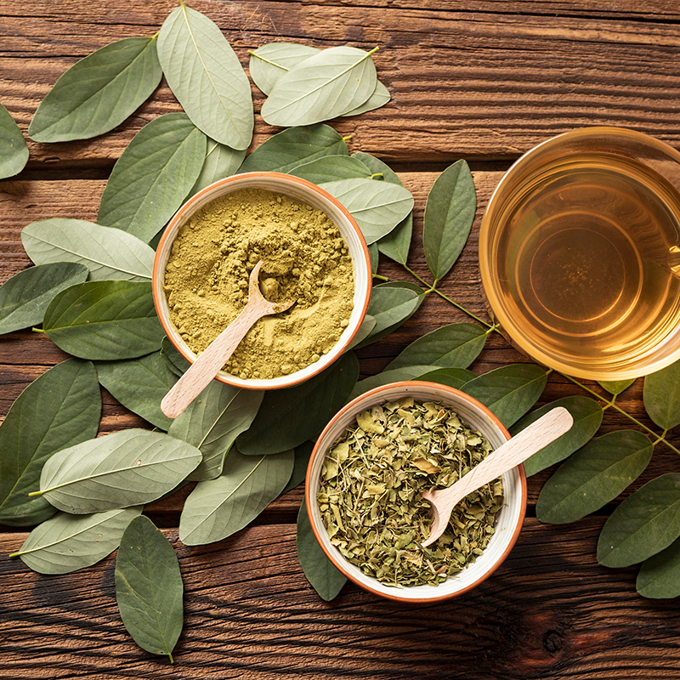
History of Aromatherapy
Ancient cultures incorporated aromatic plant components in resins, balms and oils.
Ancient Egyptians- Used aromatic oils in beauty creams and during the mummification process.
Hippocrates- “The Father of Medicine” is said to have documented the effects of some 300 plants.
China first recorded the use of aromatic oils around 2700 BC during the Yellow Emperor Dynasty.
19th Century- The term “aromatherapy” is coined by a French perfumer & chemist Rene-Maurice Gattefosse.
Notes:
For thousands of years, ancient cultures in China, India and Egypt used aromatic plant components in resins, balms and oils. It is said that Cleopatra used herbal oils in her beauty regimens and that plant essences were used in the mummification process.
Likewise, Early Greeks, such as Hippocrates, the father of medicine, is said to have adopted knowledge of essential oils from the Egyptians and documented the effects of some 300 plants.
China in 2700 BC is said to have recorded the first use of aromatic oils during the Yellow Emperor Dynasty.
Though an exact date cannot be provided, historical writers tell us that during the 16th Century, physicians in Germany began using essential oils from Lavender to help treat burns. But it wasn’t until the 19th Century that the term “Aromatherapy” was coined by a Rene Maurice Gattefosse, who was a French perfumer and chemist.
Next Slide

Slide 6
Aromatherapy is defined as…
Inhalation or bodily application of fragrant essential oils for therapeutic purposes…. In other words, the use of aroma to enhance a feeling of well-being.
“Aromatherapy.” Merriam-Webster.com Dictionary, Merriam-Webster, https://www.merriam-webster.com/dictionary/aromatherapy
Notes:
Today, the Merriam-Webster dictionary defines Aromatherapy as:
The inhalation or bodily application of fragrant essential oils for therapeutic purposes- or in layman terms, the use of aroma to enhance a feeling of well-being.
NEXT SLIDE

Slide 7
3 Common forms of Aromatherapy
01
02
03
Includes lotions and wearing accessories like bracelets made w/ absorbent materials to apply the essentail oils & smell daily.
Topical
Massage
Often used in body oils mixed with essential oils that are rubbed and massaged into the skin.
Inhalation
Most commonly used- essential oils are blended with carrier oils and used in a diffuser, candle, or Aroma stick.
Notes:
If using aromas can sometimes enhance our well-being, then what is the best way to get the fragrant aromas into our bodies?
Researchers have identified the 3 most common ways in which people benefit from Aromatherapy.
The first is Topical. Sometimes people can purchase bracelets, necklaces or other similar items which are made of absorbent materials where the essential oils can be applied and used periodically throughout the day as needed. This also includes using lotions with the addition of essential oils.
The second way is through the massaging of body oils mixed with essential oils into the skin. This is often used in spa treatments or sometimes gyms, physical therapy and rehabilitation centers where people are provided massages. What is very important to note here is that essential oils should NEVER be applied directly to any skin, without being mixed into a carrier oil, which we will discuss further later in today’s presentation.
The third and most common form of Aromatherapy is inhalation. This is when essential oils are blended with carrier oils and then used in a diffuser, candle, aroma stick, etc. Although we will touch on all 3 forms of aromatherapy today, we will focus much of the presentation on inhalation aromatherapy, which is the most common and widely used method.
Having now defined what Aromatherapy is and talked about the most common ways that we can get aromatherapy, let’s look at exactly how Inhalation Aromatherapy works.
NEXT SLIDE

Slide 8
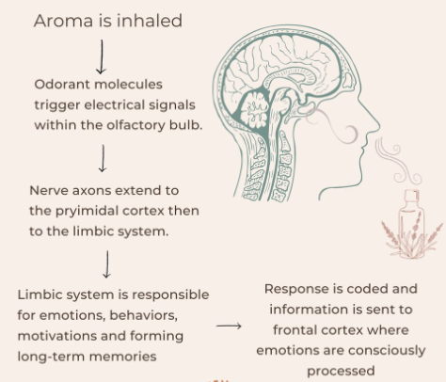
Inhalation Aromatherapy
Notes:
As we just learned Aromatherapy is the practice of using essential oils extracted from plants to enhance psychological and physical well being through topical application, massage or inhalation.
What you see here is a more detailed explanation for how inhalation aromatherapy, again the most widely used method, works. You begin by inhaling the aroma, then as you smell, receptors from the nose trigger certain signals which are relayed to different parts of your central nervous system that then relay the appropriate responses to parts of your brain where emotions are processed. This can sometimes result in changes to emotions and behaviors.
There are well over 90 commonly used essential oils, many associated with certain health benefits. You will receive a handout today with a robust list of essential oils and what potential health benefits some people identify when using a particular essential oil. I caution you to remember that each person can have individual effects and reactions to essential oils.
We won’t have time to discuss them all today, so instead let’s look at some of the most common used essential oils and some of their associated potential benefits experienced by some individuals.
NEXT SLIDE

Slide 9


02
Identify Commonly Used Essential Oils & Possible Benefits
Notes:
Research recognizes that there are mostly 4 common ways in which some people find benefits from Aromatherapy.
However, before we discuss the benefits, let’s first take a closer look at what an essential oil is? How it’s made, Etc.
NEXT SLIDE

Slide 10
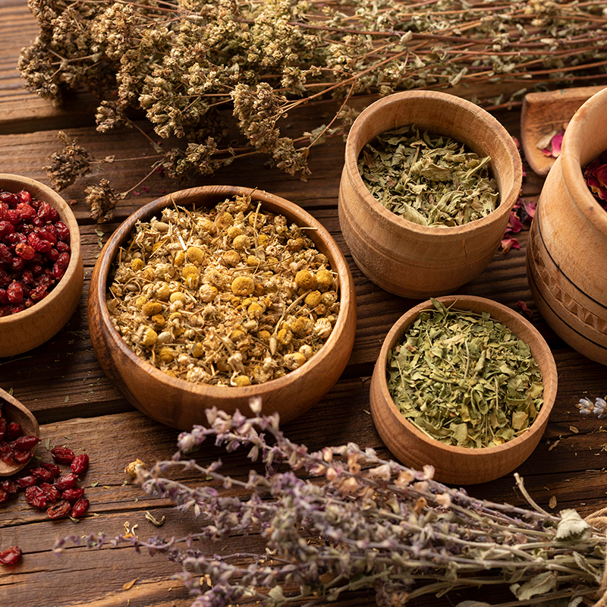
Essential oils are…
Derived from flower, herb, and tree parts, such as the bark, roots, peels, and petals.
Fragrant because of the cells in plants that provide the “essence”. When “essence” is abstracted from plants, through a process called distillation or mechanical methods such as cold pressing, it becomes essential oil.
Used most effectively as a part of inhalation aromatherapy, although they can also be diluted with a carrier oil then applied directly to the skin, such as in massage oils.
Notes:
Essential oils are captured from a variety of plant parts, including flowers, herbs, bark, roots, peels and petals.
The plant cells hold the scents, or “essence” of the plant. Thus, using a process called distillation or using a variety of steaming or cold pressing methods, the plant cells will release the “essence” which then becomes essential oil. It takes a lot of plant product to make essential oil. For example, it takes more than 200 pounds of Lavender flowers to make just 1 pound of Lavender essential oil.
It’s important to note that not all products made with plant essence are essential oils. True essential oils are not blended with other compounds during distillation or pressing to avoid changing the chemistry of the plant essence. On the market you will find a variety of products using plant essence. Thus, reading the labels of the products you buy will be very important and we too will discuss that later in the presentation.
For now let’s jump into what are the 4 most common recognized benefits associated with inhalation aromatherapy and identify the essential oils that are often used for each.
NEXT SLIDE

Slide 11
Relaxation & Stress Relief
Lavender
Bergamot
Jasmine
Frankincense
These essential oils have been found consistently to help manage sleep quality by inhibiting the central nervous system activity, helping people feel relaxed.
Notes:
The first, and most widely known benefit of inhalation aromatherapy is that of Relaxation and Stress Relief. Lavender, Bergamot, Jasmine and Frankincense are the 4 oils to have been found most consistently associated with relaxation & stress relief. A systematic review by Dr. Lee published in The Journal of Alternative and Complimentary Medicine found that the use of Lavender essential oil, through inhalation with a dose of 2 drops within 30 minutes, effectively decreased anxiety and positively impacted sleep latency, sleep duration, and sleep quality.
Moreover, the study found that when Bergamot was added to the Lavender essential oils mixture, the combination of the two was more effective than lavender oil alone for sedation and relaxation, as well as reducing anxiety and stress.
NEXT SLIDE

Slide 12
Mood Enhancement, Balance & Well-Being
Citrus
Peppermint
Jasmine
Bergamot
Vanilla
These essential oils have been found to affect some behavior due to the direct and intrinsic ability to affect the central nervous system, reducing feelings of “low energy” and in some cases improving an individual’s mental health by decreasing anxiety and stress related symptoms.
Notes:
The second area where inhalation aromatherapy has been found to have some benefits includes Mood enhancement, Balance and Well-being.
Essential oils from plants such as Jasmine and vanilla are often used as natural anti-depressants by some. However, if someone is under medical care by a physician, they should never stop their prescribed medication without consulting with their physician.
A study conducted by Herz, et al. published in the International Journal of Neuroscience looked at the facts and fiction of Aromatherapy and the olfactory effects on mood, physiology and behavior. In the study, they found that Aromatherapy induced positive feelings during exercise, reduced fatigue during exercise and when recovering. They noted that aromas like Vanilla and Citrus fragrances fooled the brains glucose level sensors, reducing the feelings of “low energy”.
Less studied, but of interest to many, is the use of Aromatherapy in mental health and nursing care homes. Some preliminary findings show that the use of inhalation aromatherapy using Bergamot essential oil and/or Lemon Balm essential oil may have positive effects with reducing agitation, anxiety and stress-related symptoms in elderly people with severe dementia. I want to re-iterate that there is not enough sound scientific research available to state that inhalation aromatherapy should be used with all dementia patients, as more research is still needed before such claims can be made.
NEXT SLIDE

Slide 13
Relief of Minor Discomfort & Pain
Ginger
Eucalyptus
Peppermint
Lavender
These essential oils have been found to support some individuals with minor discomfort and pain relief. Some potential benefits of essential oils include supporting anti-inflammation, relaxing muscles, anti-nausea, and reducing migraine headache symptoms.
Notes:
The third area where aromatherapy has been found to have some benefits includes the Relief of Minor Discomfort & Pain.
Despite being a common health issue for many, pain is extremely subjective and may be difficult for individuals to communicate. Dr. Lakhan, et al. published an article that reviewed the Effectiveness of Aromatherapy in Reducing Pain in the Journal of Pain Research and Treatment.
The study found that aromatherapy might be effective for some in treating pain or relieving discomfort. For example, it was noted that some women experiencing pain or discomfort from menstruation or in the first phase of labor delivery benefitted from deep breathing techniques coupled with inhalation aromatherapy using lavender, orange, and eucalyptus. It also found that inhalation aromatherapy with equal parts lavender, peppermint and ginger had an effect in the treatment of post-operative nausea and vomiting in some individuals.
Still other studies found that Lavender essential oil could be used to help treat symptoms of migraine headaches and serve as an anti-inflammatory for joint discomfort. Wintergreen oil and peppermint oil, the two main ingredients in over-the-counter pain-relieving ointments, were found to produce a cooling and tingling sensation when used in massage oils to relax muscles after exertion and minor discomfort from muscular injury.
As no uniform measure of pain exists and given that different people have a broad range of identified discomforts, Individual preference, cultural norms, physical illness, or psychological makeup may all contribute to how effective aromatherapy is in relieving minor discomfort or pain. Given the increased use of aromatherapy by some, the study concluded that more research is necessary to fully understand the potential use of aromatherapy in clinical applications related to minor discomfort and pain management. As such, a person should always talk with their healthcare provider to make sure that trying an essential oil is right for them..
NEXT SLIDE

Slide 14
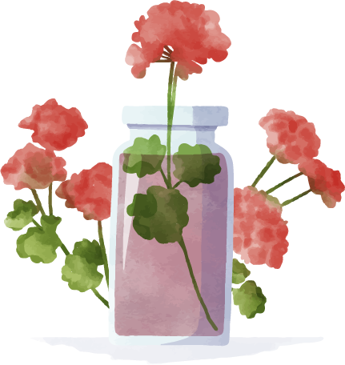
Boosting the Immune System
Lavender
Tea Tree
MAY activate cells in response to infections with some bacteria and decrease inflammation.
Has a history of use in lowering anxiety, promoting restful sleep and helping with skin problems.
MAY increase some activity in immune cells and may help reduce inflammation.
Has a history of use as an anti-inflammatory and antimicrobial with conditions such as skin problems and respiratory illnesses.
Clove
Eucalyptus
MAY increase activity in immune cells and may help reduce inflammation and known for pain-easing properties.
Has a history of use in traditional medicinal practices to ease pain, and wound care, but in high doses can actually increase inflammation.
MAY increase some activity in immune cells and may help reduce inflammation.
Has a history of use in ailments like a cough or respiratory infections.
Notes:
The fourth area where inhalation aromatherapy has been found to have some benefits includes Boosting the Immune system.
Your immune system plays an important role in keeping you healthy. When your immune system is weakened, it can make you more vulnerable to becoming ill. Because of this, it’s important to do what you can to help your immune system work to its full potential. You may have heard that essential oils (EOs) can help boost your immune system. Generally speaking, much of the information about essential oils boosting immune function is anecdotal, which means it comes from an individual’s personal experience rather than from scientific research.
Dr. Peterfalvi, et al. published an article looking at a review of essential oils supporting the immune system in the Journal Molecules. The study summarized the immune-supporting properties of essential oils found in a broad number of PubMed articles published regarding essential oils and the immune systems.
Their research found that there was some data associated with the use of eucalyptus and ginger essential oils in immune function balancing properties. However, there was not sufficient data to conclude effects because different types of immune cells or functions may be differently influenced by the same essential oil. Much more research would be needed before a certain essential oil could definitively be said to impact the Immune system.
However, the most common immune system “enhancing” essential oils, reported anecdotally by some users are Lavender, Eucalyptus, Tea Tree and Clove, as you can see here on this slide. Please remember that these oils MAY help with boosting the immune system, however, they have not been found to do so definitively through research.
NEXT SLIDE

Slide 15
03
Discuss Carrier Oils &
Their Role in Aromatherapy
Notes:
As mentioned earlier in the presentation, we are now going to take a deeper look into carrier oils and the role they play in aromatherapy.
NEXT SLIDE

Slide 16

Carrier oils are…
Derived from plant parts similar to essential oils.
Used to dilute essential oils and “carry” them because essential oils applied directly to skin will cause irritation.
Mostly unscented or lightly scented to avoid interfering with the esssential oil’s therapeutic properties.
Often oils used to nourish or moisterize the skin.
Notes:
Carrier oils are an incredibly important part of aromatherapy, whether you are using topical, massage or inhalation. They are important because pure essential oil is very potent and should be diluted- ALWAYS when being applied directly to the skin.
Carrier oils with little to no scent are best to use to avoid interactions with the aroma of essential oils.
Many choose to use carrier oils that are already known to help moisturize the skin and are easily absorbed. Let’s take a look at some important points to consider when choosing carrier oils on the NEXT SLIDE.

Slide 17
Selecting a Carrier Oil… Consider the Following:
Odor
Absorption
Avoid carrier oils with strong scents to avoid altering the essential oil aroma
Identify carrier oils that are absorbed easily into the skin- not all oils are
Skin Type
Shelf Life
Avoid carrier oils that irritate the skin or worsen conditions such as acne
Identify Carrier oils that can be stored for long periods of time
The U.S. Food and Drug Administration (FDA) does NOT regulate carrier oils used for cosmetics; however, they do regulate edible cooking oils.
Notes:
When you are considering what type of carrier oil to use with essential oils, there are 4 important things to consider- they are:
Odor- as we just mentioned, it’s best to select unscented or lightly scented carrier oils to avoid altering the aroma of essential oils.
Skin Type- Some carrier oils can have adverse effects on the skin, including rashes or acne breakouts. Avoid these oils.
Absorption- Not all oils are easily absorbed into the skins, I’m sure you can think of some oils or lotions that leave you feeling more greasy verses soaking into the skin. It’s best to avoid using those carrier oils.
Shelf life- This is another important point to consider. When purchasing carrier oils, often bulk purchasing may seem like the best deal. However, be certain to find a carrier oil that can be safely stored for a long period of time, as you will most likely not need large amounts of carrier oil at once.
Very important to note, that similar to essential oils, the FDA does NOT regulate carrier oils that are used primarily for cosmetics. FDA DOES however regulate edible cooking oils; thus, some people will choose carrier oils that serve dual purposes in the kitchen and as a carrier oil for aromatherapy. Let’s take a look at some of the common carrier oils on the NEXT SLIDE.

Slide 18
Commonly Used Carrier Oils
Coconut oil
Jojoba oil
Apricot kernel oil
Sweet Almond oil
Olive oil
Argan oil
Rosehip oil
Black seed oil
Grape seed oil
Avocado oil
Sunflower oil
ALWAYS do a PATCH TEST prior to using a carrier oil.
Add a drop of carrier oil to inside of wrist or just below the ear.
Cover the oil with a bandage.
Check back on the area in 24 hrs.
If irritation occurs, rinse thoroughly and avoid future use.
**When possible, choose carrier oils that are cold pressed and from a trusted manufacturer.
Notes:
Listed here are some of the most commonly used carrier oils. You will note that many are oils that you might also use in the kitchen. ALWAYS be careful when selecting carrier oils if you have a known allergy, such as to nuts. If that is the case, the person will want to avoid carrier oils such as sweet almond oil, apricot kernel oil, Argan oil and any tree nut oils.
Before using any carrier oil, it is ALWAYS advised to perform a patch test prior to using the oil. The steps for completing a simple patch test are found here in the box on the slide.
Add a drop of oil to the inside of the wrist or just below the ear.
Cover the oil with a bandage.
Check back on the area in 24 hrs.
If irritation has occurred, rinse thoroughly and avoid future use of that oil.
One additional note is to consider choosing carrier oils that have been cold pressed and from a trusted manufacturer. This method of pressing, in most cases, will provide a more concentrated oil.
NEXT SLIDE

Slide 19
04
Safety & Precautions when using Essential Oils
Notes:
Throughout the session today, there have been times when we highlighted the need to speak with a healthcare provider before using a form of aromatherapy. Before we conclude today’s session, we want to highlight a few additional safety and precautions to be aware of when using essential oils.
NEXT SLIDE

Slide 20
Safety and Precautions
The U.S. Food and Drug Administration (FDA) does NOT regulate essential oils.
Side effects
Medications
Pregnancy
Essential oils can:
Irritate eyes, skin, or mucus membranes in the nose
Lead to Migraine like headaches
Cause nausea or vomiting
Essential oils can:
Pose dangerous drug interactions- especially with some post-operative medications.
Interact with anticoagulants, sedatives, antidepressants/antipsychotics, some diabetes medications and some cancer treatments- always talk with a physician about possible interactions.
Never use Essential oils on:
Pregnant Women
Infants and children
Without first talking to a physician.
Notes:
We cannot stress enough that the U.S. Food and Drug Administration (FDA) does NOT regulate essential oils. This means that essential oil products can vary in purity, strength, and quality across manufacturers. Be sure to only purchase essential oils from reputable and trusted brands and manufacturers.
As we discussed previously, essential oils can be inhaled or applied topically when mixed with a carrier oil. Never apply undiluted essential oils directly to the skin. Do not swallow essential oils and ALWAYS Do a skin patch test before applying diluted essential oils to your skin.
Additionally, be mindful that individuals react differently to different fragrances. For example, although Lavender is often touted to ease migraine headache symptoms, there are some who are very sensitive to aromas and the scent of lavender can actually trigger a migraine headache. Essential oils can have unwanted side effects such as irritation to eyes, skin or mucus lining in the nose, trigger headaches or cause nausea and vomiting.
Again, although earlier in today’s session we heard of a study where women suffering from menstrual and/or childbirth discomfort and pain may have benefitted from the use of breathing exercises coupled with a form of inhalation aromatherapy, that is not always the case. Essential oils should NEVER be used on infants, children or during pregnancy without first consulting with a physician.
Individuals are often under the impression that because essential oils are derived from natural, plant-based substances, they’re a safe and pose little to no health risk. As such they may not feel it’s relevant to disclose it to their healthcare provider. But because essential oils do contain high concentrations of active compounds that are metabolized by the body when inhaled or applied topically, there is a very real possibility for dangerous drug interactions. Thus, always talk to a physician about possible interactions of using essential oils with your medications.
NEXT SLIDE

Slide 21
Pet Safety
Pets react differently than humans to essential oils
Use an abundance of caution when it comes to essential oils and pets. It is BEST TO AVOID diffusing essential oils around pets. REMEMBER: Pets have a more sensitive sense of smell compared to humans and pets lick and groom themselves often!
Always consult with your veterinarian about the safety of using products marketed for pets containing essential oils, such as shampoos or calming sprays!
Notes:
With the increased interest and popularity in using essential oils, it’s a common question to ask- Are essential oils safe for my cats and dogs?
In general, an abundance of caution should always be used with essential oils near pets. There are dangers of ingestion, inhalation and even with topical use.
Pets react differently than humans to essential oils and ultimately it is best to avoid essential oils in any form around pets. For example, let’s say you wanted to use a diffuser with essential oils in your living room or bedroom to help you unwind before bedtime. Will your pet be coming to join you in bed or lay in their own bed/spot in the living room while you read or watch TV? What harm would turning a diffuser with an essential oil be to a pet, as long as you are in the room and can avoid having the pet knock the diffuser over?
Well,
Remember that a pet’s sense of smell is keener and more sensitive to aromas compared to humans. Also, besides inhalation exposure to pets,
While the diffuser is on, microdroplets of essential oils could collect on your pet’s fur, and could lead to dermal exposure, leading to a skin rash/allergy for your pet.
What if the pet is licking or cleaning itself? Could they then be ingesting some of the essential oils that have collected on their fur?
In humans, essential oils are easily absorbed through the skin and mucus membranes and later easily metabolized to eliminate them through the liver. Cats and dogs, however, lack the enzyme needed to break down essential oils and thus essential oils may cause a range of unfavorable health outcomes for these pets, including corrosive burns to the gastrointestinal track, respiratory distress and even liver failure.
The fact is, even if certain essential oils found in pet shampoos and calming sprays are marketed as safe for pets, it is best to ALWAYS ask your veterinarian about the safety of these products before using them on your pet.
NEXT SLIDE

Slide 22
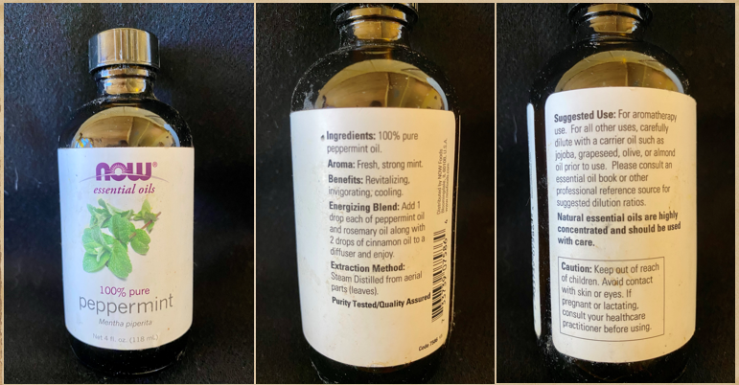
In Conclusion…Buyer Be Ware!
Read labels carefully for scientific plant name, purity, extraction method and suggestions for use.
Remember to buy from a reputable vendor/manufactuer too!
ALWAYS consult your healthcare provider/physician before choosing to use a form of aromatherapy. Especially NEVER stop or replace a medical treatment plan with essnetial oils without first talking to your physician!
Notes:
Lastly, as we conclude today’s presentation on Aromatherapy and the use of essential oils, remember to always use caution when buying products that are NOT regulated by the FDA!
If you choose to purchase essential oils, remember to read the label carefully for plant names, purity and other information that might be listed on the bottles, including suggested uses.
Remember that essential oils should never be placed directly on skin, so it’s equally important to choose carrier oils that will compliment the essential oil and work well for your needs.
Be mindful that just because an essential oil may have a positive benefit to you does not mean that others will have the same benefit! So be sensitive to others when diffusing essential oils in your home or office.
And remember that our furry friends react differently than humans to essential oils, so be careful with diffusing essential oils near pets for extended periods of time and always consult their veterinarian before trying out new shampoos or calming sprays containing essential oils.
In conclusion, if you have an interest in utilizing a form of Aromatherapy, whether topical, massage or inhalation, ALWAYS consult your healthcare provider or physician first and NEVER stop or replace medical treatment with essential oils without first talking to your physician.
NEXT SLIDE

Slide 23
Thanks!
Do you have any questions?
Notes:
Thank you for attending today’s session. Do you have any questions?

Slide 24
Resources
“Aromatherapy.” Merriam-Webster.com Dictionary, Merriam-Webster, https://www.merriam-webster.com/dictionary/aromatherapy
https://www.researchgate.net/profile/Milica-Acimovic/publication/349485550_Essential_Oils_Inhalation_Aromatherapy_-A_Comprehensive_Review/links/6032d264a6fdcc37a84249c8/Essential-Oils-Inhalation-Aromatherapy-A-Comprehensive-Review.pdf
Lakhan SE, Sheafer H, Tepper D. The Effectiveness of Aromatherapy in Reducing Pain: A Systematic Review and Meta-Analysis. Pain Res Treat. 2016;2016:8158693. doi: 10.1155/2016/8158693. Epub 2016 Dec 14. PMID: 28070420; PMCID: PMC5192342
Lee, Y.L.; Wu, Y.; Tsang, H.; Leung, A.; Cheung, W.M. A systematic review on the anxiolytic effects of aromatherapy in people with anxiety symptoms. The Journal of Alternative and Complementary Medicine 2011, 17, 101-108; DOI:10.1089/acm.2009.0277
Herz, R.S. Aromatherapy facts and fictions: a scientific analysis of olfactory effects on mood, physiology and behavior. International Journal of Neuroscience 2009, 119, 263–290; DOI:10.1080/00207450802333953.
Peterfalvi A, Miko E, Nagy T, Reger B, Simon D, Miseta A, Czéh B, Szereday L. Much More Than a Pleasant Scent: A Review on Essential Oils Supporting the Immune System. Molecules. 2019 Dec 11;24(24):4530. doi: 10.3390/molecules24244530. PMID: 31835699; PMCID: PMC6943609.
https://news.okstate.edu/articles/veterinary-medicine/2018/essential-oils-and-pets.html

